Slide 1

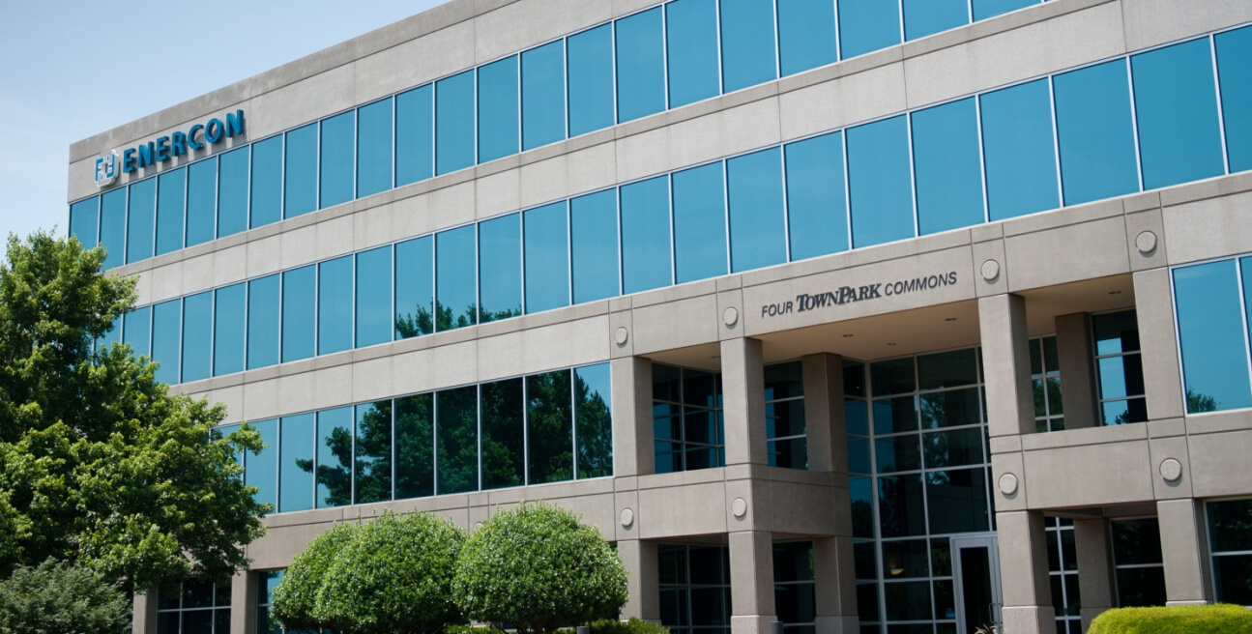

Slide 2
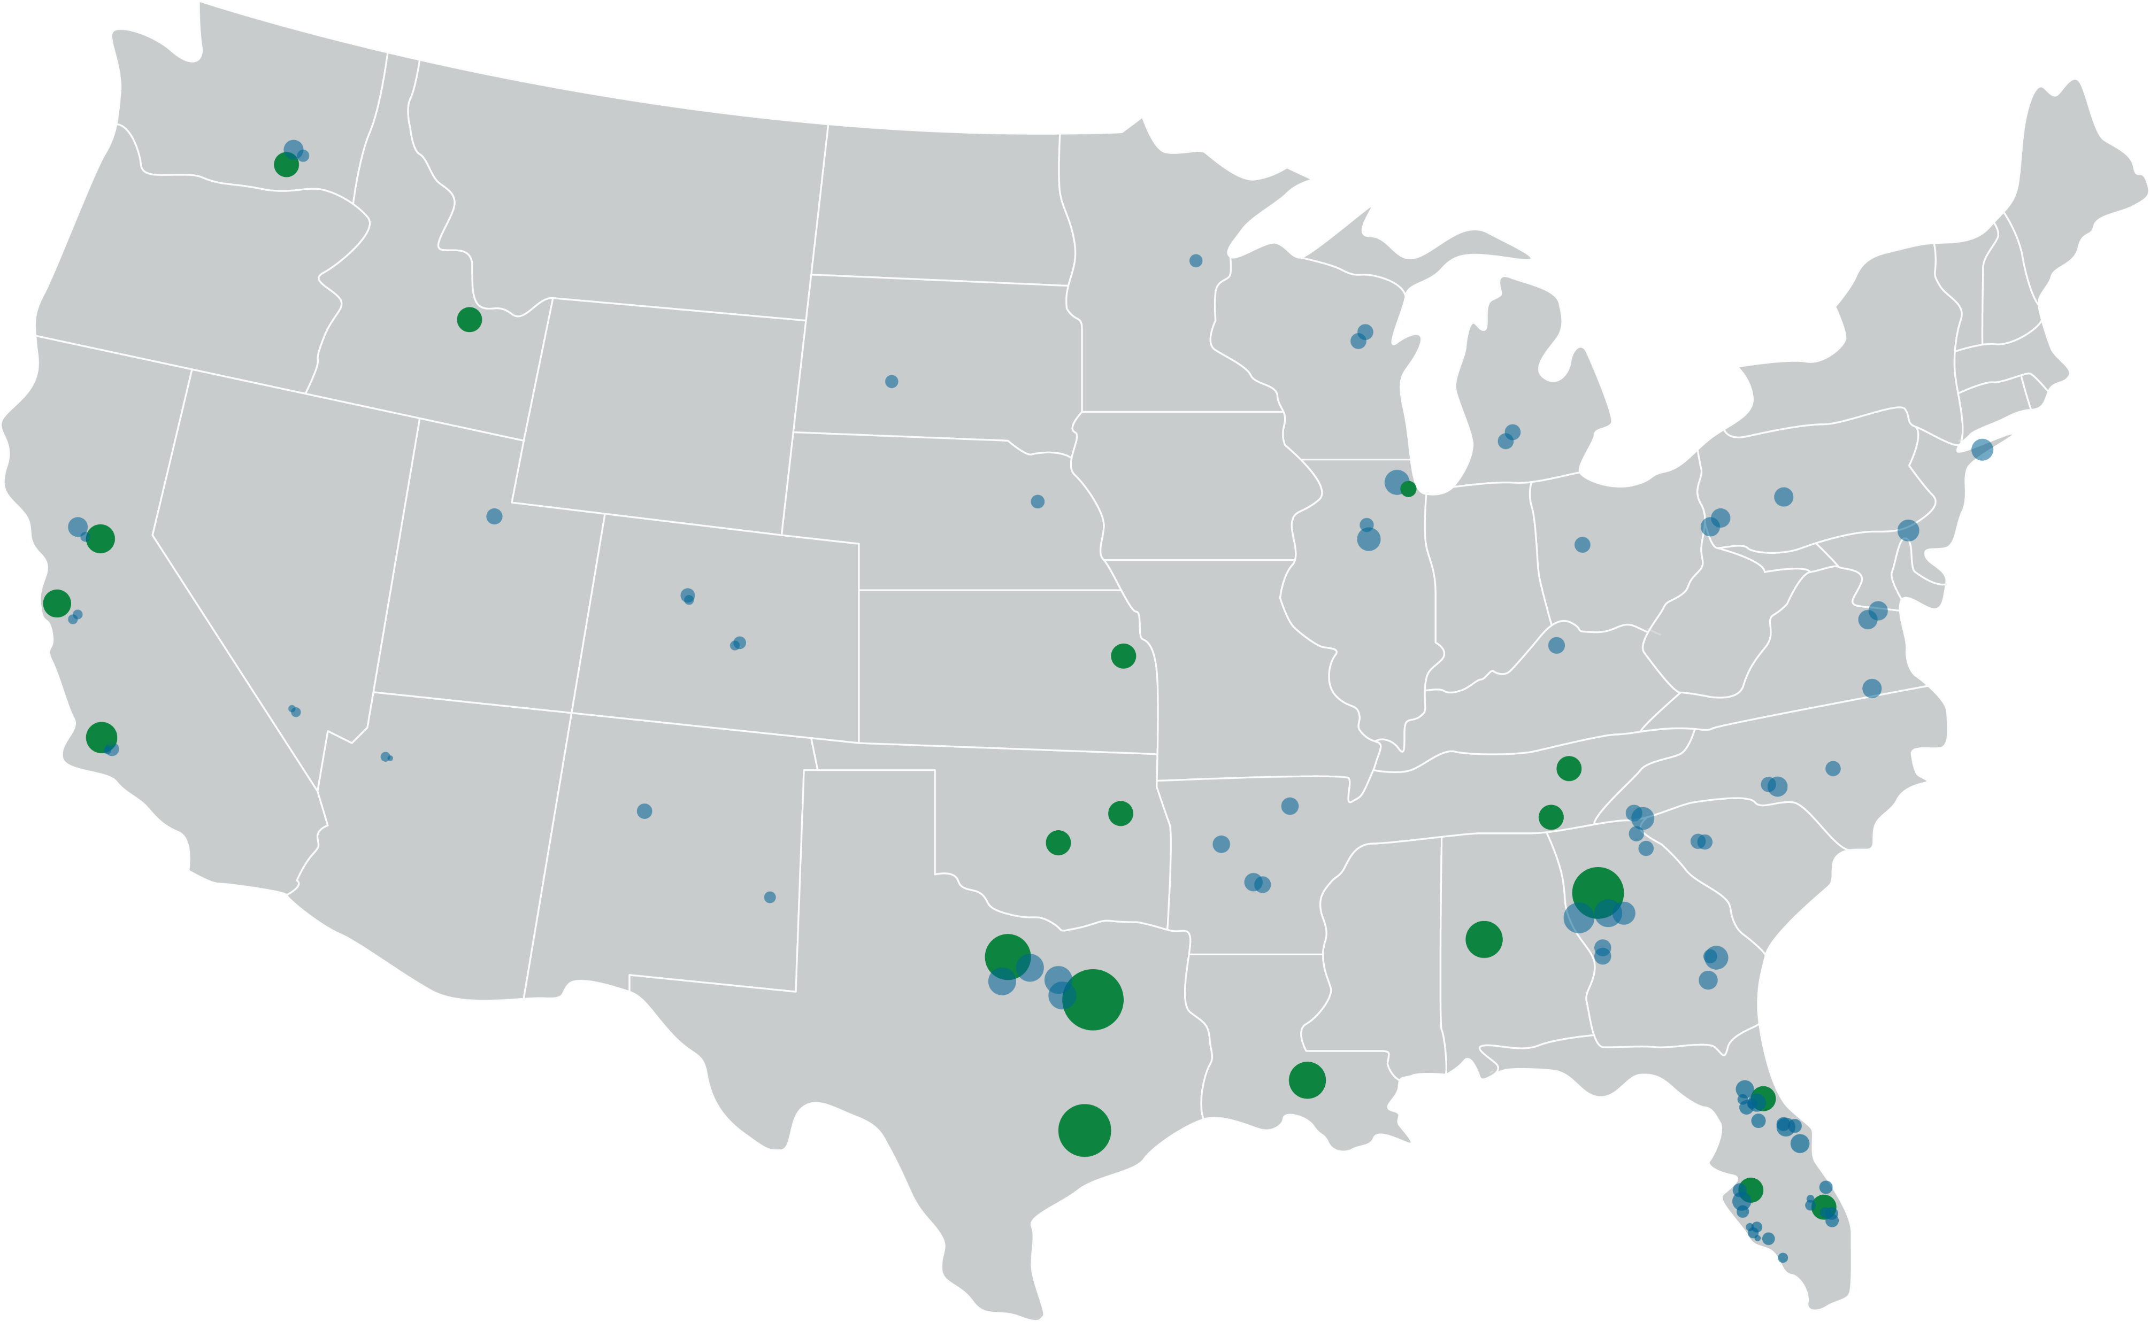


About ENERCON
ENERCON Office Locations
ENERCON Employee Locations
1,300+
20
Employees
US Offices
39
74
#2 Nuclear Power
#9 Co-Generation
#15 Power
#26 Power Delivery
#74 Top 500 Design Firms
Year History
ENR Top Firm
Safety
Innovation
Experience

Slide 3

ENERCON
NSG
EG
ESG
ENERCON
4/28/2022
3

Slide 4



Nuclear Service Group (NSG)
NextEra Energy (NEE)
Entergy (ENT)
Southern Company (SE)
Tennessee Valley Authority/Dominion (TVA)
Talisman (TAL)
Enercon Federal Services (EFS)
Chiefs
4/28/2022
4

Slide 5
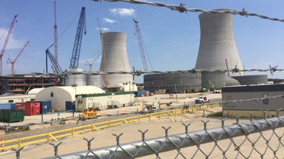
Nuclear Service Group (NSG)
Design & Consulting Services
  Design changes
  Technical & commercial studies
  General project coordination
  License Renewal
  Calculations, drawings, specs
Regulatory & Industry Issue
Security
Emergency Preparedness
Grid Stability
Severe Weather
Upgrading & Degrading Equipment
Pumps & Motors
Control Systems
Valves
Cooling Towers
Piping
Cables
Building Structures
4/28/2022
5

Slide 6
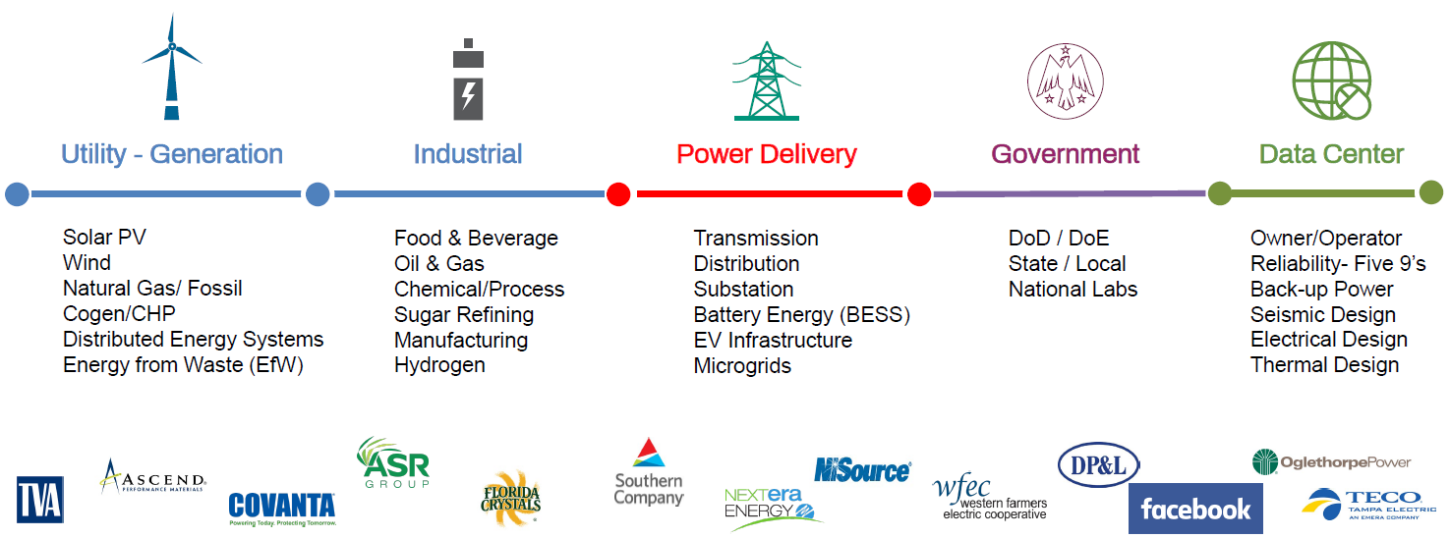
Energy Group (EG)
4/28/2022
6

Slide 7

Environmental Service Group (ESG)
Pipeline Integrity
Permitting
  Pipeline, transmission, and Wind/Solar projects
Threatened and Endangered species:
  Licensed biologist identify trap and relocate if needed
Cultural/historic resources:
  Archeological Digs
  Historic Properties
  Cultural sites
Compliance Services:
  Air
  Oil Field
  Storm Water
  Erosion Control
4/28/2022
7

Slide 8
Environmental Service Group (ESG)
Industrial Hygiene and Safety
  Asbestos and Lead paint surveys
  Indoor Air quality and Mold
Due Diligence Services
  Recognized environmental conditions that may affect property value in advance of purchase or sale.
Geoscience/Site Investigation:
  Plume Modeling- measured change in aquifer chloride level
Remediation:
  storage tank removals
Decommissioning Services:
  reactor decommissioning, waste packaging & shipment
4/28/2022
8

Slide 9
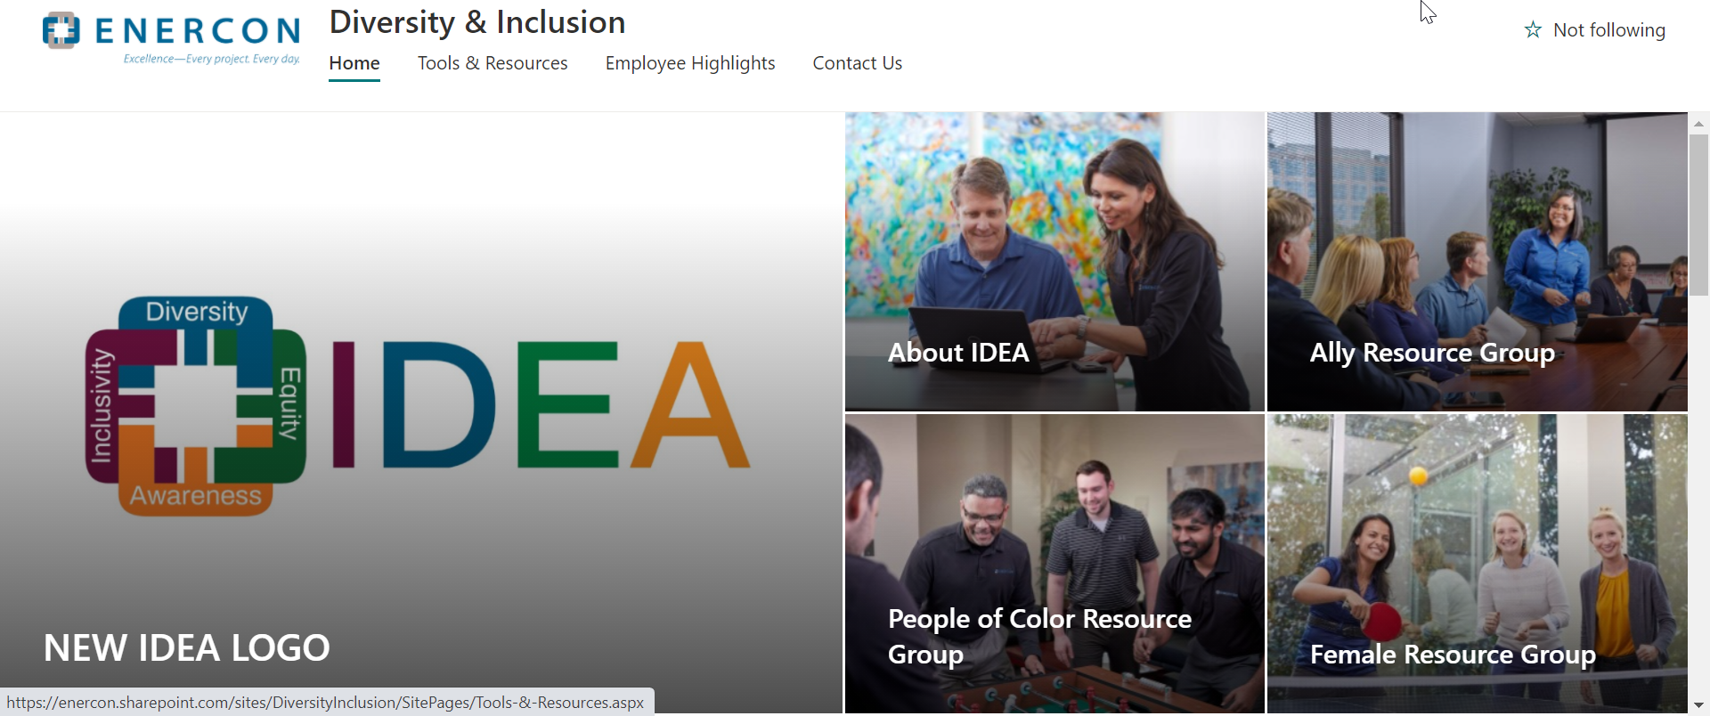
Inclusivity, Diversity, Equity, & Awareness
We desire that all individuals, regardless of background, that apply or work for ENERCON feel a sense of belonging
We believe that diversity is
crucial to organizational success
We strive to provide the necessary tools & resources to enhance each individual’s abilities
Through education, practice, and promotion, we are constantly increasing awareness throughout the organization

Slide 10
Why ENERCON?
Growth Opportunities
401k Match
Alternate Work Schedule (AWS)
Hybrid work schedule
Education Reimbursement
Health, Dental, Vision, etc.
4/28/2022
10

Slide 11
Who we want
Civil/Structural
Electrical
Mechanical
Project Manager
Drafters/designers
Chemical/Aerospace
4/28/2022
11

Slide 12

Accommodations
If you are an individual with a disability and require reasonable accommodations in order to complete an application for employment, or during any step throughout the hiring process, please email applicationhelpHR@enercon.com

Slide 13
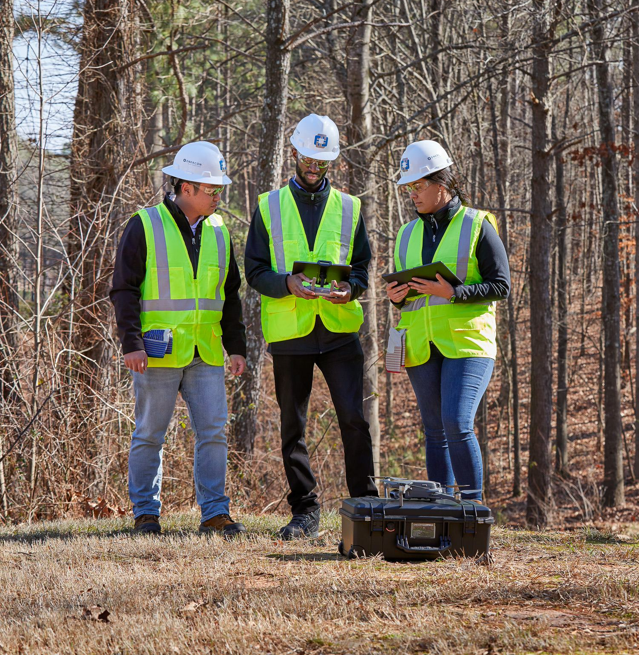
CONNECT WITH US!
WE'RE EXCITED TO WORK WITH YOU!
LinkedIn:
www.linkedin.com/company/enercon-services
Website:
http://www.enercon.com
Careers:
https://www.enercon.com/careers
Thank You!

